Slide 1

A Comparison of Blockchain-Based Wireless Sensor Network Protocols
Presented by-
Akshay Manoj
Notes:
Hello My name is Akshay Manoj and I will be presenting the paper titled “A Comparison of Blockchain-Based Wireless Sensor Network Protocols”

Slide 2
Introduction
What are Wireless Sensor Networks?
Wireless Sensor Networks are formed from groups of scattered sensors tasked with the collection and transmission of data. The most common use cases for these networks are for military tactical reconnaissance. Applications for these networks do also exist in other fields such as ecology where they are used for animal tracking and forest fire detection
What is Blockchain?
Blockchain is effectively a secure decentralized database stored on network nodes. Hence, blockchain is a distributed protocol.
Notes:
First we must ask what are wireless sensor Networks and what is Blockchain?
Basically WSN’s are a group of sensors communicating with each other and collecting and transmitting data,
You can find WSN’s in military recon , home automation, weather monitoring etc.
While Blockchains can be thought of as a secure decentralized database stored on the network nodes , in essence it’s a distributed protocol

Slide 3
Objective of the paper
Perform a comparison of at least five popular blockchain-based Wireless Sensor Networks protocols research papers
Identify characteristics in algorithm design and network topology among Wireless Sensor Network protocols that successfully improved throughput
Propose a new algorithm for Wireless Sensor Networks based on the characteristics identified as contributing to throughput
Notes:
The objectives of the paper are as follows:
1. perform a comparison of blockchain based WSN protocols from their research papers
2. Identify what makes the protcols successful in improving through put
3. Finally propose a new algorithm for WSN based on the attributes identified

Slide 4
Algorithms and Protocols used in Blockchain based networks
Block Compaction Algorithms
Block Routing Protocols
Consensus Protocols
Notes:
Block Compaction : One example of a block compaction algorithm is the Invertible Bloom Lookup Table. Invertible Bloom Lookup Table is a technique used in the Bitcoin network to lower block propagation times. This technique uses XOR and hashing to compress transactions into a fixed structure [1]. Moreover, with this technique, the node being synced will receive only new transactions instead of all transactions [2]
Block Routing : The aim of block propagation algorithms is to timely share data in the network without the involvement of a third party. The physical network determines things like how many miners there are (in the case of Bitcoin), and each node’s available bandwidth
Consensus Protocols: Authentication protocols are used in networks to determine how nodes communicate with each other. Authentication protocols are critical because they determine how available and fault tolerant a network is likely to be; both of which are key characteristics of a network’s scalability. In blockchain networks, to maintain security without a third party, data on the state of the blockchain ledger is routed between nodes in the network

Slide 5
A. Moinet, B. Darties and J.-L. Baril’s Protocol
A scheme aimed at improving node authentication and identifying trusted nodes with some limited improvement to wireless sensor network throughput
Algorithm used a trust-based algorithm to route data to network nodes based on the amount of time data is present in the network and the event reputation.
Use of timers limits the possibility of denial of service attacks and therefore improved throughput.
Does not consider the capacity of the nodes to improve throughput
Notes:
The first protocol that the paper compares is a protocol proposed by Moinet,Darties and Baril
In this protocol a trust based algorithm is used to route data to network nodes.
This protocol uses timer and event information to decide which nodes are trust worthy and which are not
Since timers are used in the protocol this means that attacks that throttle the network like DOS are less effective.
Drawback is that this protocol doesn’t consider Node capacity to improve throughput

Slide 6
S. R. Anand, R. C. Tanguturi and S. R. D. S Protocol
Combines the AdHoc On-Demand Distance Vector (AODV) Routing Protocol with Particle Swarm Intelligence Optimization (PSO)
The AODV algorithm is used to get all the paths between the source and destination and the PSO heuristic is used to find the least congested path in the network
Limited improvement to throughput as the algorithm lowers the impact of network congestion.

Slide 7
G. Ramezan and C. Leung’s protocol
A Blockchain-based routing protocol with results five times faster than the standard Ad Hoc On-Demand Distance Vector (AODV) routing protocol for Wireless Sensor Network.
Algorithm was aimed at Internet of Things networks and used smart contracts to find network paths
The disadvantage of this method is because it uses Ethereum smart contracts, nodes will need to pay gas to block producers whenever routing is required. Hence, this method is expensive
Notes:
This protocol is based on Ethereum smart contract system.
It has seen to perform a lmost 5 times faster than the AODV method
Since it uses etherium smart contracts it

Slide 8
Y. Ren, Y. Liu, S. Ji, A. K. Sangaiah and J. Wang’s Protocol
Proposed a routing algorithm that incentives nodes to participate in routing data
This algorithm aims to prevent nodes from engaging in storage and energy conservation which could in turn cause less nodes to be available and therefore decrease network throughput
Use of this scheme is limited only to Wireless Sensor Networks where it is possible to offer a reward to nodes
Their proposed algorithm also applied a data compression scheme that lowers the amount of data stored in a node by 256 bits
Notes:
This protocol uses routing algorithm that adds a reward system to the block chain to incentivise nodes to participate in routing data
Secondly it prevents the nodes from doing any kind of storage or power saving
This is algorithm is obviously limited by the fact that it can only be used in a situation where such a reward can be applied to the WSN.
They also use a data compression algorithm to offer a reward to the Nodes

Slide 9
J. Yang, S. He, Y. Xu, L. Chen and J. Ren’s protocol
proposed a blockchain routing protocol aimed at improving the throughput of the blockchain in addition to the security
their proposed algorithm used machine learning, specifically reinforcement learning, to quickly identify malicious nodes and thereby improve the security of the network

Slide 10
Y. Xu, G. Wang, J. Yang, J. Ren, Y. Zhang and C. Zhang’s protocol
Proposed an algorithm that modifies the consensus algorithm to improve throughput in the network.
To improve throughput in the network, a proof-of-authority consensus algorithm is employed which they proved has better throughput compared to a proof of work consensus algorithm
The proof of authority consensus algorithm requires nodes to stake their reputation instead of coins as with the proof of work algorithm
While control does not reside in the hands of one node, there is still centralization here as control resides in a collective body of nodes.

Slide 11
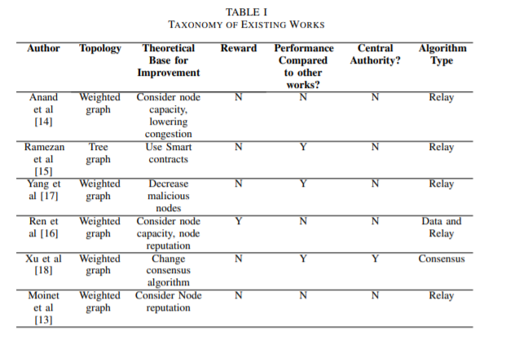
Notes:
This table shows the comparison of the previously discussed protocols, I will describe some of the categories for comparison Topology:
Theoretical base for improving throughput:
Blocks in a blockchain store transactions. The distribution of these blocks in a blockchain network is called block propagation.
Increasing throughput in blockchain networks requires smaller block sizes and/or shorter block propagation times
Trust-based methods for improving throughput were used to lower network congestion, reduce attacks/decreasing malicious nodes, and apply smart contracts.
Rewards:
Offering rewards such as digital currency to incentivize nodes to use additional storage or energy is not a popular strategy in Wireless Sensor Networks
May conflict with the node’s mission or simply not interest nodes.
An algorithm using rewards is not ideal for improving throughput in Wireless Sensor Networks.
Central Authority:
In ad hoc Wireless Sensor Networks, having a single point of failure (which is what a central node for authentication represents) is not ideal
The ideal routing protocol for a wireless sensor network lies in algorithms that do not rely on a centralized node or centralized group of authority nodes
Algorithm Type:
This section represents change directly applied to an algorithm to improve throughput
Algorithm type is characterized as either a data compression based algorithm, a block relay/routing algorithm, or a consensus algorithm
More success with improving network throughput by modifying block relay.

Slide 12
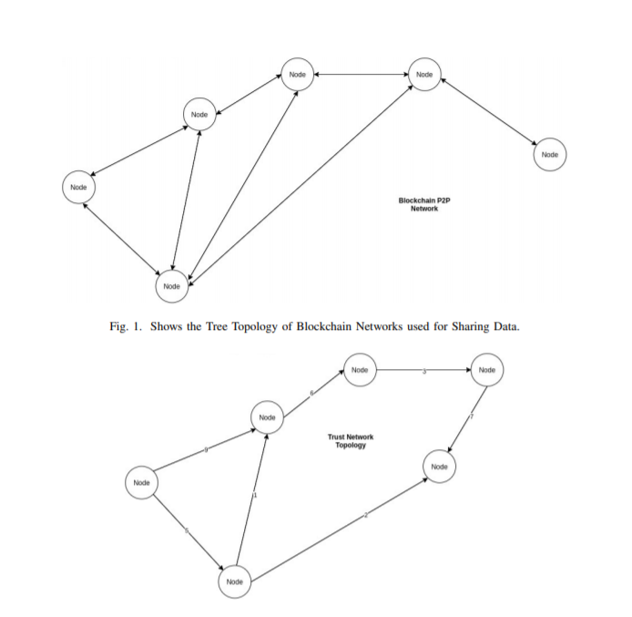
Topology

Slide 13
Summary of Positive Characteristics for Improved Throughput
Trust management supported with a weighted graph topology (5 of the 6 algorithms proposed in the taxonomy utilized trust values to improve throughput)
Use of a relay algorithm modification instead of data compression-based algorithm for improving throughput
An algorithm that does not reward nodes with digital currency (5 of 6 algorithms proposed in the taxonomy did not use digital currency to incentivize block propagation)
Decentralized nodes in the network for improved security and lower congestion (5 of 6 algorithms proposed in the taxonomy did not use a centralized authority)
Notes:
From the table we can summarise that
That most algorithms prefer to use the weighted graph topology
Most prefer to use the data relay algorithm over compression for improving throughput
Using reward system for nodes is not preferred
Decentralised nodes of authority.

Slide 14
Proposed New Algorithm
A new algorithm that utilizes weighted trust management when routing nodes with a proof-of-authority (POA) consensus algorithm.
In this new algorithm, nodes were assigned trust values between one and ten, and were based on the node’s bandwidth capacity
Nodes with a trust value of one were considered most malicious while nodes with a value of ten were considered least malicious
Reinforcement learning was also used to update trust value
Notes:
Best Algorithm would be some combination of Moinet and Xu’s proposed algorithm.
Moinet described a trust management system that used reinforcement learning while Xu applied a consensus algorithm that relied upon trust management’
The nodes in the new algorithm have an associated trust value from 1-10 (1 being not trustworthy, and 10 being most trustworthy)
Using these trust values the network decides where to route data to next.
Once the Trust values are updated we use reinforcement learning techniques to ensure that every node updates the trust value of its neighboring nodes.

Slide 15
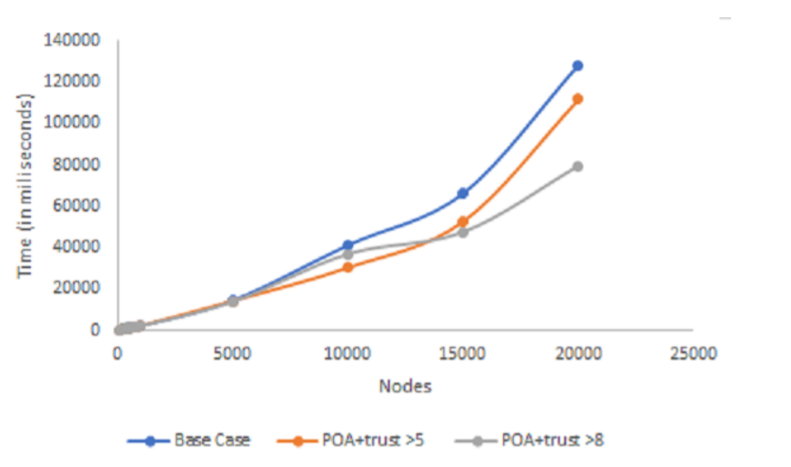
Performance of the New Algorithm
Notes:
The new algorithm was evaluated on a blockchain network that accepted node trust values over 5 and on another blockchain network that accepted node trust values over 8
The base case for the performance evaluation is the block propagation routing protocol
which picks a node from a pool of available nodes and then chooses candidates at random to send data
Results from the new algorithm indicate that blockchain networks with higher trust threshold perform better
As the number of nodes in the network scaled to 20000 nodes, the POA algorithm that considered trust values
over 5 (POA+trust¿5) propagated in 111765 milliseconds while the POA algorithm that considered trust values
over 8 (POA+trust¿8) propagated in 79483 milliseconds
the performance of the algorithms is very similar until the network has approximately 10000 nodes

Slide 16
CONCLUSIONS
Scalability could be influenced by the choice of consensus algorithm, the network’s congestion, the number of malicious network nodes, the choice of topology.
A summary of the most converged upon algorithm characteristics for improving throughput and thereby scalability were identified.
A novel algorithm for Wireless Sensor Networks which leverages these characteristics was designed and implemented
The novel algorithm utilized trust management for nodes in addition to a proof of authority consensus algorithms

Slide 17
References
https://www.researchgate.net/profile/Abena_Primo/publication/344850333_A_Comparison_of_Blockchain-Based_Wireless_Sensor_Network_Protocols/links/5f93785e458515b7cf9917cc/A-Comparison-of-Blockchain-Based-Wireless-Sensor-Network-Protocols.pdf
A. Moinet, B. Darties and J.-L. Baril, ”Blockchain based trust and authentication for decentralized sensor networks,” ArXiv, 2017.
S. R. Anand, R. C. Tanguturi and S. R. D. S, ”Blockchain Based Packet Delivery Mechanism for WSN,” International Journal of Recent Technology and Engineering (IJRTE), vol. 8, no. 2, pp. 2277-3878, 2019
G. Ramezan and C. Leung, ”A Blockchain-Based Contractual Routing Protocol for the Internet of Things Using Smart Contracts,” Security, Privacy, and Trust on Internet of Things, vol. 2018, 2018
Y. Ren, Y. Liu, S. Ji, A. K. Sangaiah and J. Wang, ”Incentive Mechanism of Data Storage Based on Blockchain for Wireless Sensor Networks,” Research on Efficient Data Forwarding in Vehicular Networks, vol. 2018, 2018
J. Yang, S. He, Y. Xu, L. Chen and J. Ren, ”A Trusted Routing Scheme Using Blockchain and Reinforcement Learning for Wireless Sensor Networks,” Sensors, vol. 19, no. 4, p. 970, 2019.
Y. Xu, G. Wang, J. Yang, J. Ren, Y. Zhang and C. Zhang, ”Towards Secure Network Computing Services for Lightweight Clients Using Blockchain,” Wireless Communications and Mobile Computing, vol. 2018, 2018.

Slide 18
THANK YOU!

